Slide 1

University Institute of Liberal Arts and Humanities
Course Name – Communication Skills
Course Code – 23PCH-105
Ethics in communication
DISCOVER . LEARN . EMPOWER

Slide 2
COURSE OBJECTIVES
The Course aims to:
1 | Augment students overall communication and interpersonal skills by making them realize the importance of good oral and written English Language in professional life.
2 | Enrich their reading capability with special emphasis on expanding vocabulary and grammatical formations.
3 | Build exceptional speaking, reading and writing skills by correcting grammatical errors and pronunciation through practice.
4 | Enhances soft skills by fostering self awareness, confidence and a positive attitude in students’ ability to communicate effectively in English.

Slide 3

Course Outcomes
On completion, the students are expected to:
CO Number | Title | Level
CO1 | Apply appropriate Listening, Speaking, Reading and Writing Skills (LSRW Skills) with correct non-verbal cues to attain expertise in soft skills. | Apply
CO2 | Apply correct contextual and comprehensible written text in the form of paragraph writing, short compositions business correspondence, using logical support and argument in a wide range of communication situations. | Apply
CO3 | Demonstrate linguistic competence while speaking and during presentations through accuracy in grammatical usage, vocabulary, pronunciation and intonation. | Apply
CO4 | Evaluate information as critical readers, speakers and writers applying ethics in communication and being sensitive in cross cultural communication. | Evaluate
CO5 | Create original, digital content for websites, blogs, vlogs and personal social media profiles etc. | Create
Academia.com

Slide 4

Introduction
“Ethics is the difference between what you have a right to do and what is right to do.”
- Potter Stewart
4

Slide 5
Difference Between Ethics, Morals and Values?
Values: are the foundation of a person's ability to judge between right and wrong. Values include a deep-rooted system of beliefs.
Morals: which are formed out of values. They're the actual system of beliefs that emerge out of a person's core values.
Ethics: is a system of moral principles. They affect how people make decisions and lead their lives. Ethics is concerned with what is good for individuals and society.

Slide 6
MORAL – BELEFES INDIVISIUAL OR GROUP WHAT IS RIGHT WHAT IS WRONG
ETHICS – PRINCIPLE WHICH HELP THE INDIVIDULAL OR GROUP TO DECIDE WHAT IS GOOD AND WHAT IS BAD
VALUE - an individual's accepted standards of right or wrong.

Slide 7

Ethical Values
LAW ABIDING
RESPONSIBILITY
INTEGRITY
RESPECT
HONESTY
FAIRNESS
CARING
RELIABILITY
ACCOUNTABILITY
josephsononbusinessethics.com

Slide 8
Ethical Communication
In communication, ethics work to enhance credibility, improve the decision-making process and allow for trust between the two parties.
This allows both parties to define what is acceptable to allow for better relations between individuals and different departments, in the case of organizations.
Unethical communication threatens quality of communication and consequently the well-being of individuals and society.

Slide 9
Ethical Communication- Definition
Moral principles and standards that guide the conduct of individuals and their behaviour.
Standards that offer guidance about the choices we make.
Fundamental to responsible thinking, decision making and development of relationships.
Enhances human worth and dignity

Slide 10

What does it mean to be an ethical communicator?
It means-
Treating people fairly, communicates honestly.
Avoiding language that manipulates, discriminates or exaggerates.
Not hiding negative information behind an optimistic attitude.
slideshare.net

Slide 11
Influencing factors of Ethical Communication
Promote a climate of caring and mutual understanding.
Strive to understand and respect other communicators before evaluating and responding to their messages.
Condemn communication that degrades individuals and humanity through distortion, intolerance, intimidation, coercion, hatred, and violence.

Slide 12

Why Do Organizations Have a Code of Ethics?
To set the right culture
To enhance the productivity
To develop team Work
To increase public Image and
brand Value
To touch new level of
successes
To remain in compliance with
laws and regulations

Slide 13
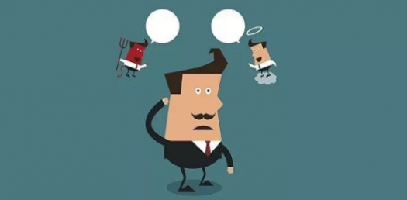
What is an Ethical Dilemma?
An ethical dilemma is a conflict between alternatives, where choosing any of them will lead to a compromise of some ethical principle and lead to an ethical violation.
Every person may encounter an ethical dilemma in almost every aspect of their life, including personal, social, and professional.

Slide 14
ETHICS DILEMMA – COMPLEX SITUATION
a situation in which a difficult choice has to be made between two courses of action,

Slide 15

Characteristics of Ethical Communication
HONESTY
TRUTHFULL
LISTNING WITH OTHER SPEAK
RESPECT
www.lookfordiagnosis.com

Slide 16
4 Standards to Ethical Communication Decision
1. Political perspective- Helps us understand ethical practices based on a value system – freedom of speech, religion and press.
2. Dialogical perspective - Based on the ability to improve mutual understanding and dialog between participants for which intellectual tolerance is necessary.

Slide 17
4 Standards to Ethical Communication Decision
3. Human perspective- Consider implications of our message and weigh costs and benefits of exercising our right to free speech. 4. Situational perspective - Audience analysis and context of the communication event, needs to be considered.

Slide 18
Factors Influencing Ethical Communication
Truthfulness, accuracy, honesty and reason are essential to the integrity of ethical communication.
Endorse freedom of expression, diversity of perspective and tolerance of dissent to achieve informed and responsible decision making.
Strive to understand and respect other communicators
Condemn communication that degrades individuals and humanity through distortion, intolerance, intimidation, coercion, hatred and violence.

Slide 19

Ethical Dilemmas in communication
Secrecy
Whistle-blowing
Leaks
Rumour and gossip
Lying
Ambiguity
tutorialspoint.com

Slide 20
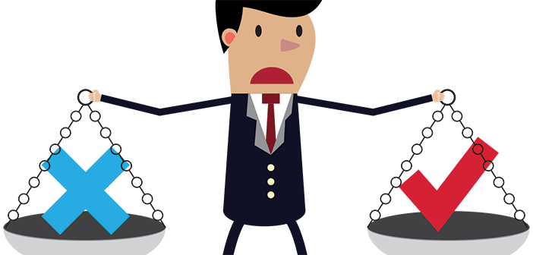
How to Respond to an Ethical Dilemma?
Legal Considerations
Moral Considerations
Keep Messages Accurate
Avoid Deception
Keep others Confidences
Ensure Timeliness of Communication
Confront Unethical Behaviour
cbtnews.com

Slide 21
DO’s & Don'ts
Do’s-
Do identify your audience.
Do stay true to your purpose.
Do choose the right time, right place and right medium.
Don'ts-
Don’t lie.
Don’t take a negative tone.
Don’t use only one communication method.

Slide 22
How would you respond to this?
Your friend insisted that she was not drunk and was perfectly capable of driving her car, but you could tell that she was completely intoxicated and a threat to herself and others on the road.
1.How would you persuade her to stay off the road?
2.Would it be ethical to lie to her to separate her from her car keys?
3.If she proved unresponsive to your persuasion and drove off, would you call the police to alert them to a dangerous driver?
Continued…

Slide 23
How would you respond to this?
4.If she were arrested for "driving while under the influence," how much of your role in the affair would you reveal?
5.In what ways, if any, would your reactions differ if your friend were a "he" instead of a "she"?
6.How would you respond if the person involved were a family member, a parent or grandparent?

Slide 24
Practice Questions
Read each question and answer truthfully.
1.It is important to have a good ____________ to show you can be positive even when you don't like something you have to do.
2. Strong __________________ means you are known for doing the right thing because you have a high sense of moral and ethical behavior that earns respect of others.
3.You are a person with a high level of ______________ if you stand by your values even if others put pressure on you to do something that is wrong or if they make fun of you.

Slide 25
Practice Questions
(Choose the right word)
A. Appearance B. Respect
C. Attendance D. Character
E. Attitude F. Integrity
4.This work ethic is important because when you are at work, you are expected to perform your duties without wasting time or getting paid for doing very little.______________

Slide 26
Be Ethical ! Be Proud!
All the while, it is important to remember two things:
Ethics doesn’t judge whether you are a good person or bad person. It provides a framework in which we can agree on the ground rules for how to live together.
Ethics isn’t designed to solve all of your dilemmas or tell you the meaning of life. It only addresses how we can get along with each other.

Slide 27
“A good decision can benefit millions, while an unethical one can cripple our future.”

Slide 28
Applications
Understanding importance of right/wrong communication.
Using ethical standards while communicating in personal and professional life.

Slide 29
Assessment Pattern
Students are assessed on the basis of the following parameters:
Hourly Test – 2
Assignments
Surprise Test
Quiz
End Semester Exam

Slide 30
References
https://www.flipkart.com/ethics-communication-3rd/p/itme2zqmeyvrsppu
https://www.pragationline.com/engineering/professional-communication-and-ethics-i-mathew/
https://upjourney.com/real-life-examples-of-ethical-dilemmas
https://en.wikipedia.org/wiki/Ethics_in_business_communication
www.rysec.org/10-basics-of-ethical-communication/
study.com/academy/lesson/ethical-communication-in-theworkplace.html
https://examples.yourdictionary.com/difference-between-ethics-morals-and-values.html
https://quizizz.com/admin/quiz/581b4c4dcb1a86df32eb2673/work-ethics

